Slide 1
Semi-selective hydrogen seeding onto the bigraphene

Slide 2
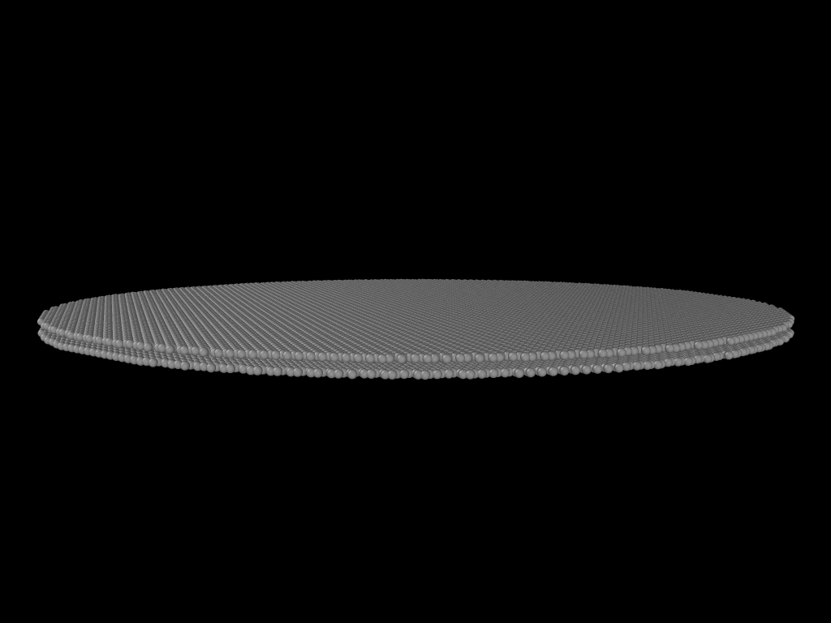
The main idea is to compare the ideal structure of hydrogen deposition (the largest number of interlayer bonds formed inside bigraphene) and the realistic case when hydrogen deposition occurs in patches and then spreads throughout the entire bigraphene. The model used a circular cutout of bigraphene; to implement the boundary conditions, hydrogen was deposited inside the circle of an even smaller radius.

Slide 3
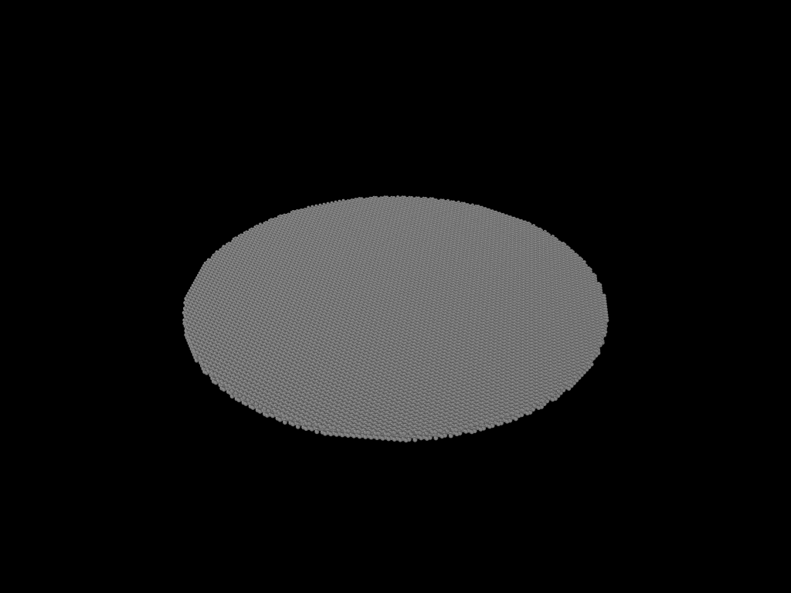
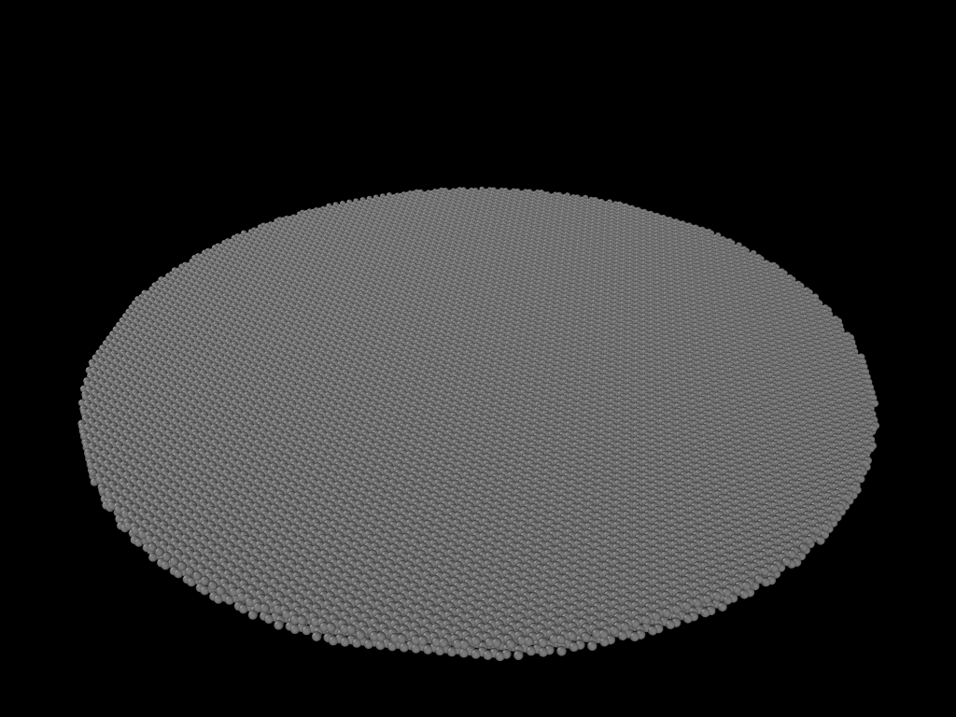
This is implemented through 2 different algorithms. The first is the presentation of a ready-made structure and its immediate optimization(left one). The second is gradual hydrogen deposition with intermediate optimization between iterations(right one).

Slide 4
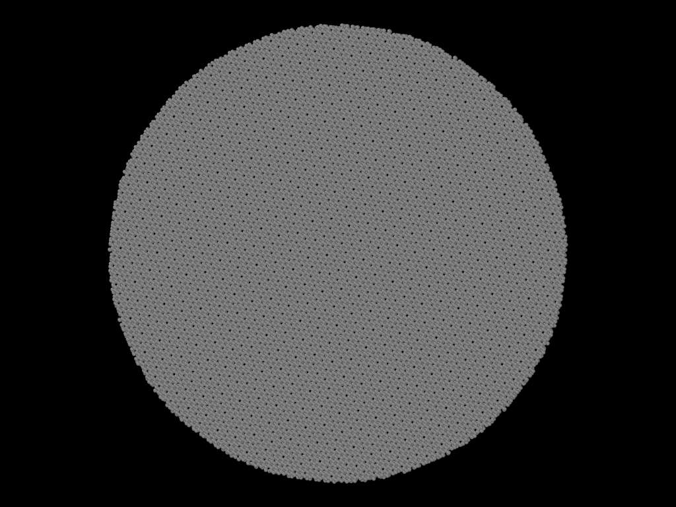
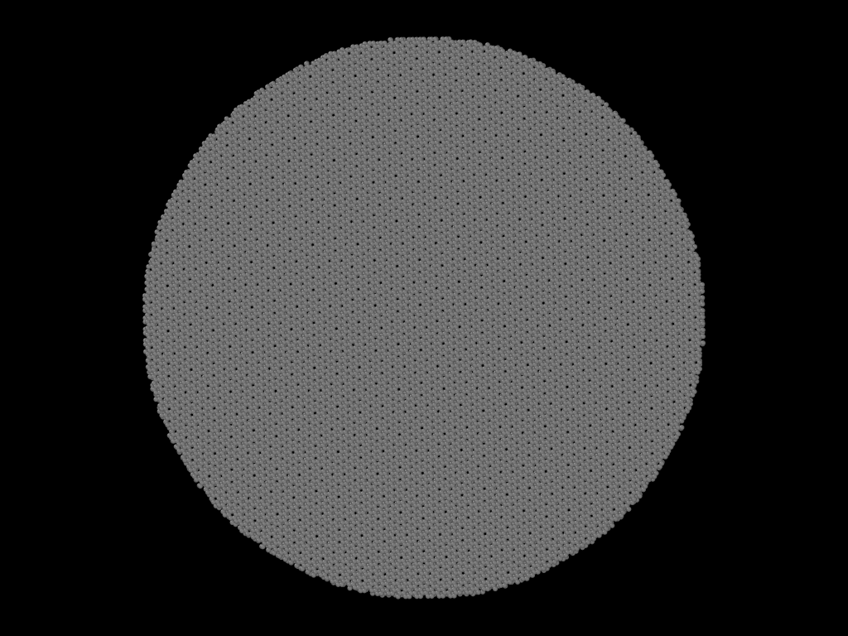

Slide 5
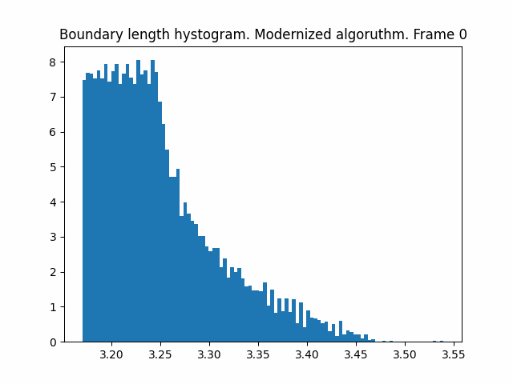

Distributions of bond lengths between two neighboring carbons from different layers were also obtained; further, candidates for the formation of an interlayer bond

Slide 6
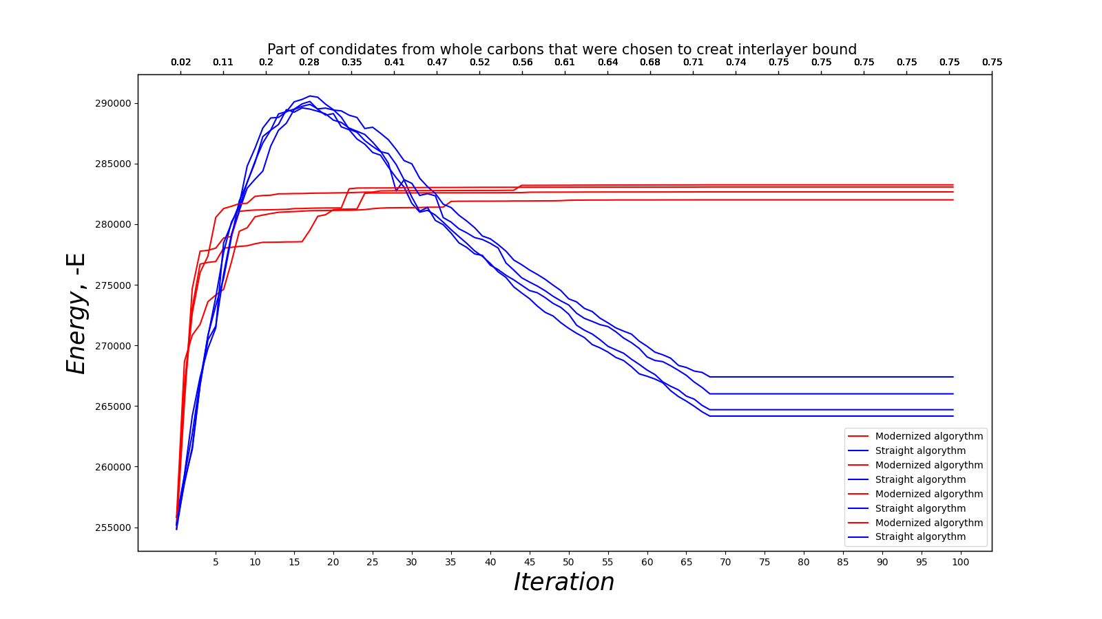
Evolution of system with different hydrogen seeding algorithms

